Slide 1
Customers Segmentation Analysis
Theophilus Ebode

Slide 2
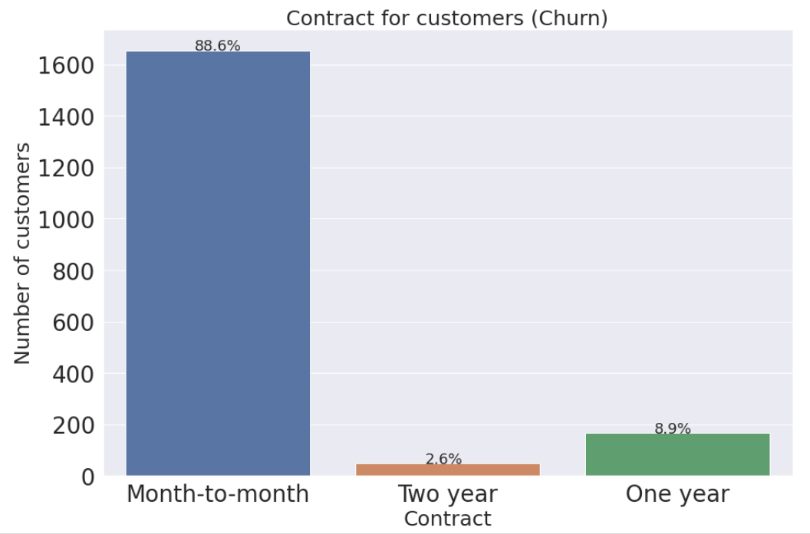
Churn rate by contract type

Slide 3
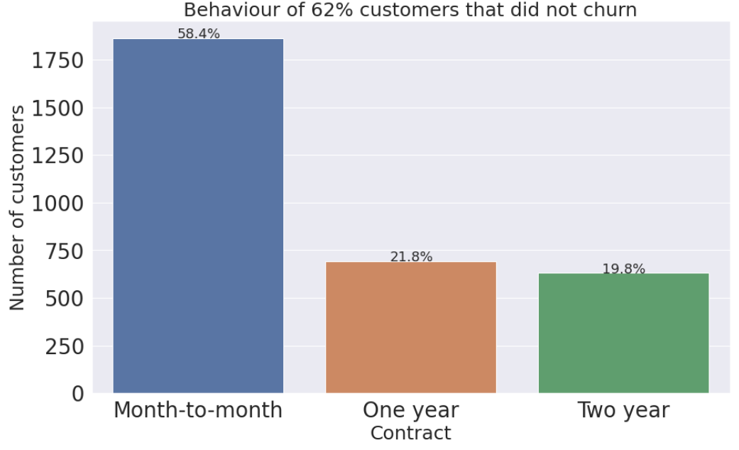
Predominant behavior of customers that left are month-to-month contract

Slide 4
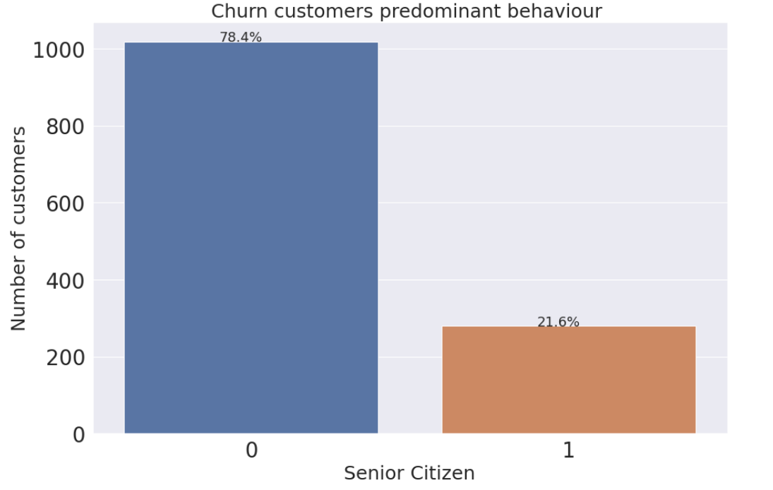
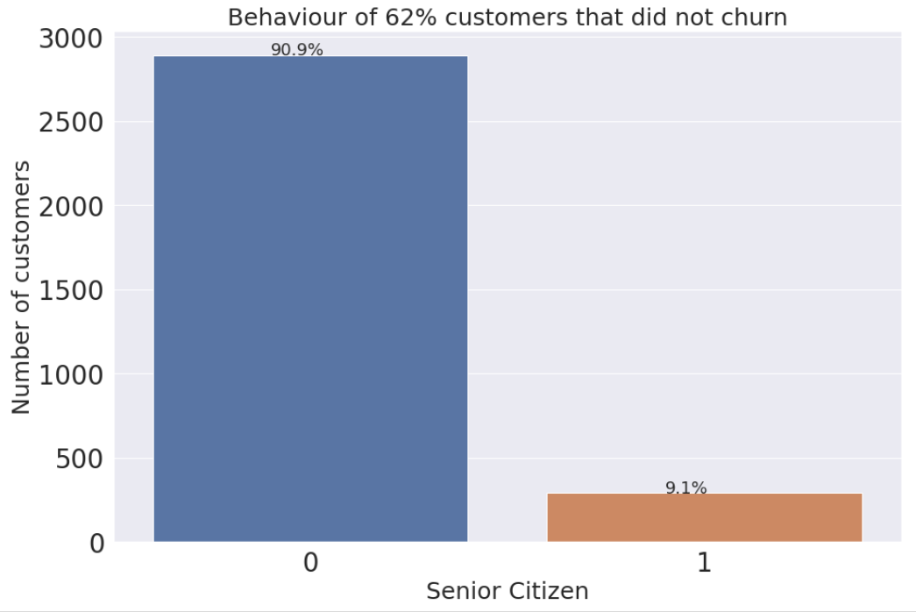
Age profile of predominant behaviors of customers that left

Slide 5
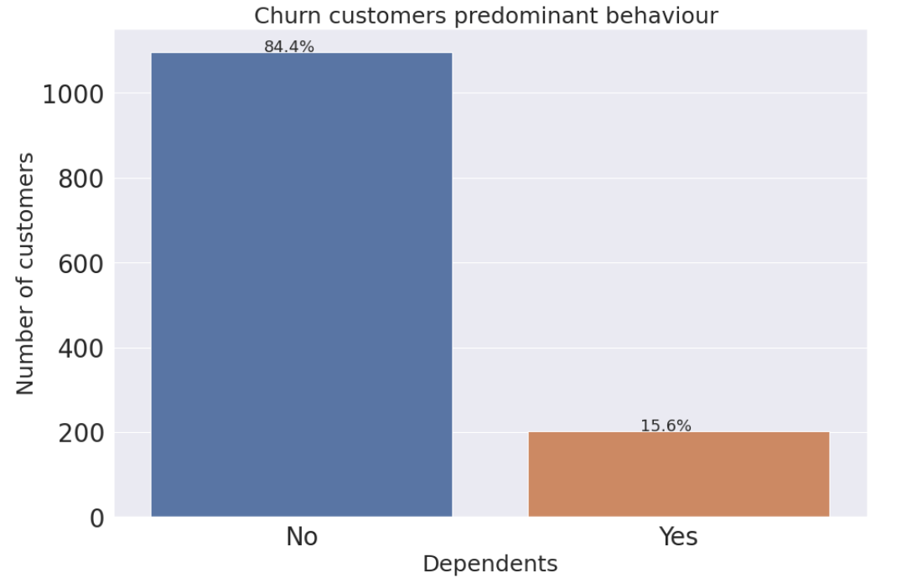
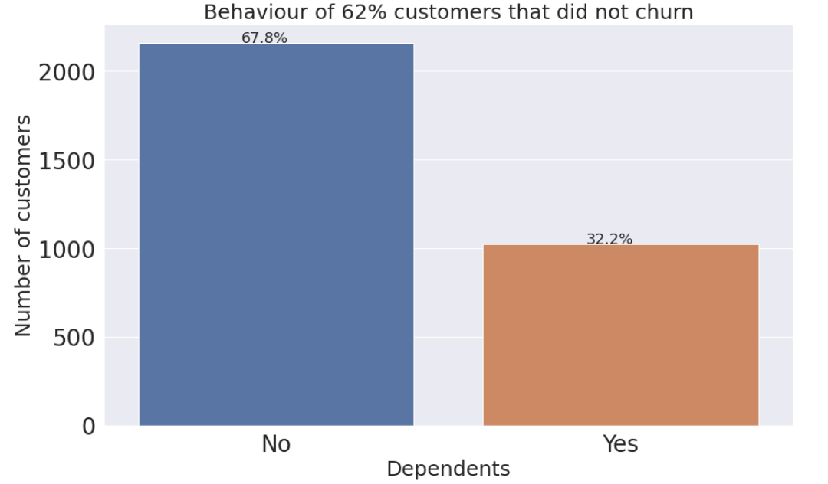
Dependents

Slide 6
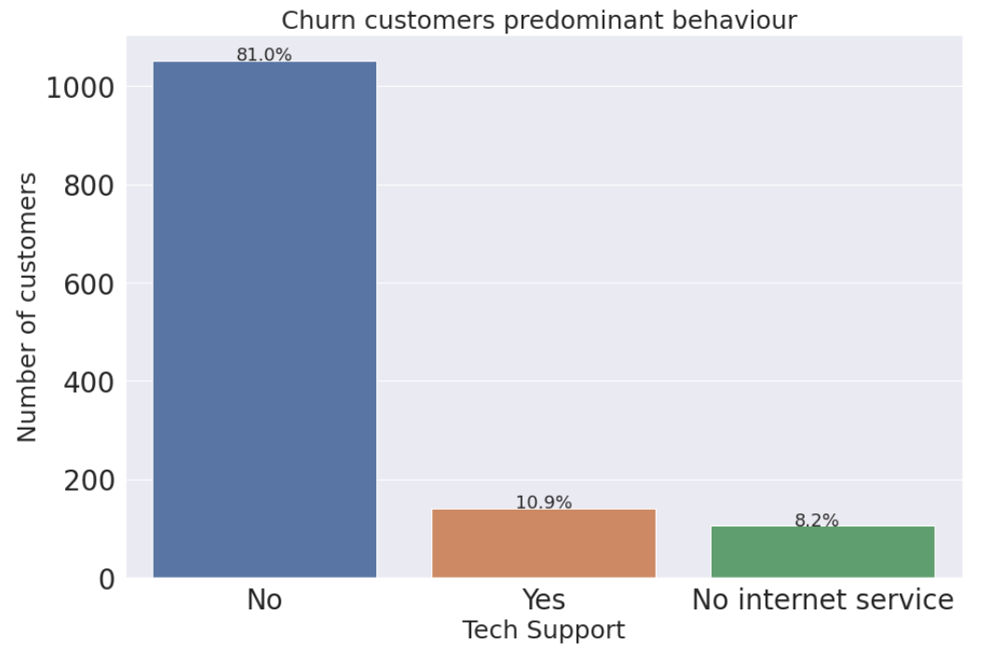
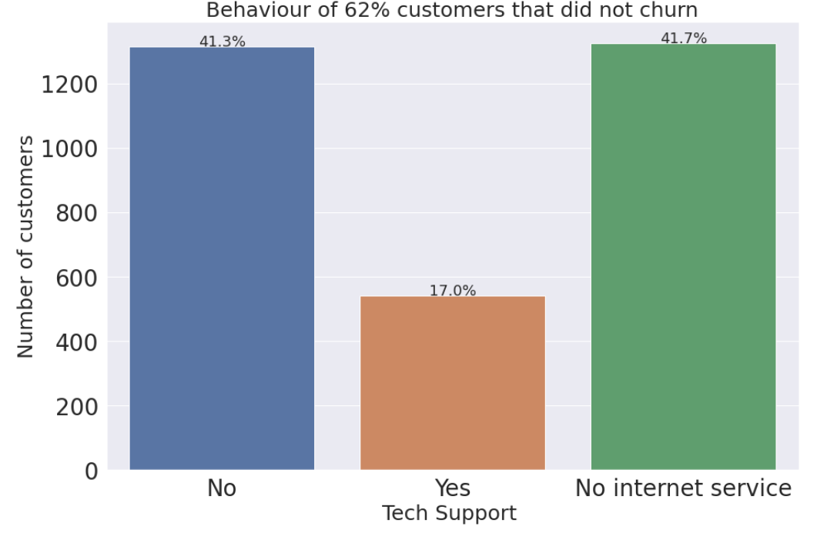
Tech support

Slide 7
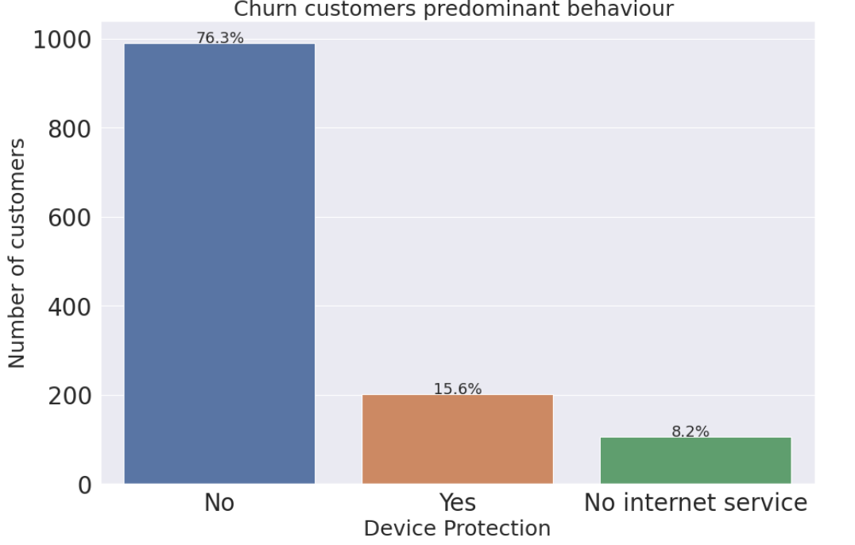
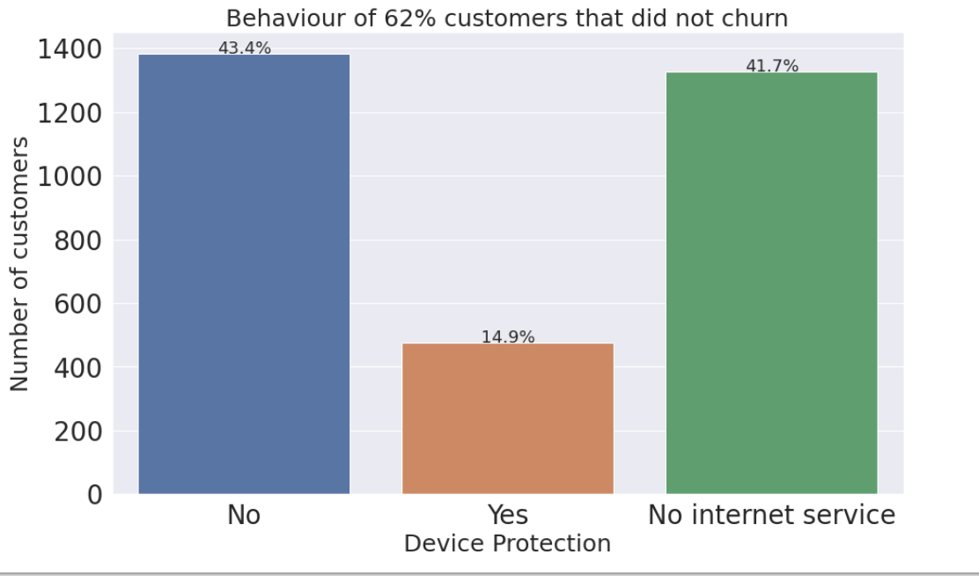
Device protection

Slide 8
Device protection

Slide 9
Observations from customers that left
87% of all customers that left are on month-to-month contract.
Besides this, clustering technique shows a segment made up of 70% of these customers with these observations
78% are not senior citizen
84% have no dependents
81% don't have tech support
76% have no device protection

